Slide 1

Data Analysis for Business Applications
A Data Science approach to Frama’s online business
By José Monzón Egana

Slide 2
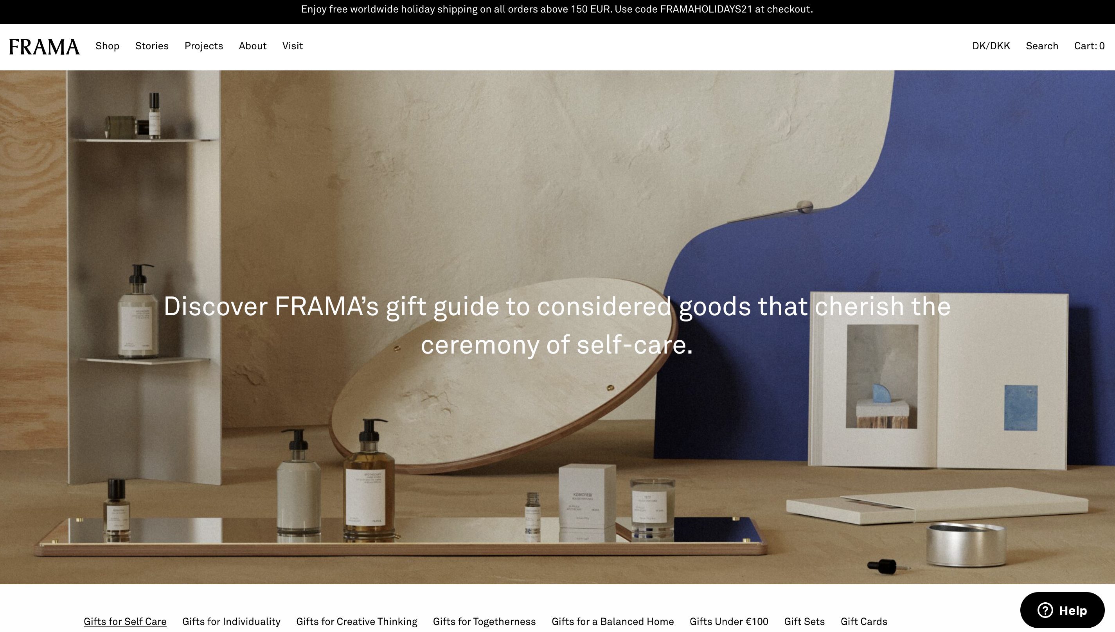
Introduction to the case

Slide 3
Introduction to the problem
The company has been growing during the past years and now has enough revenue to start investing in advertisement.
Which are the markets with the biggest potential?
Which are the collections that generate more interest in the audience?
Are there any similarities or patterns between these possible customers?

Slide 4
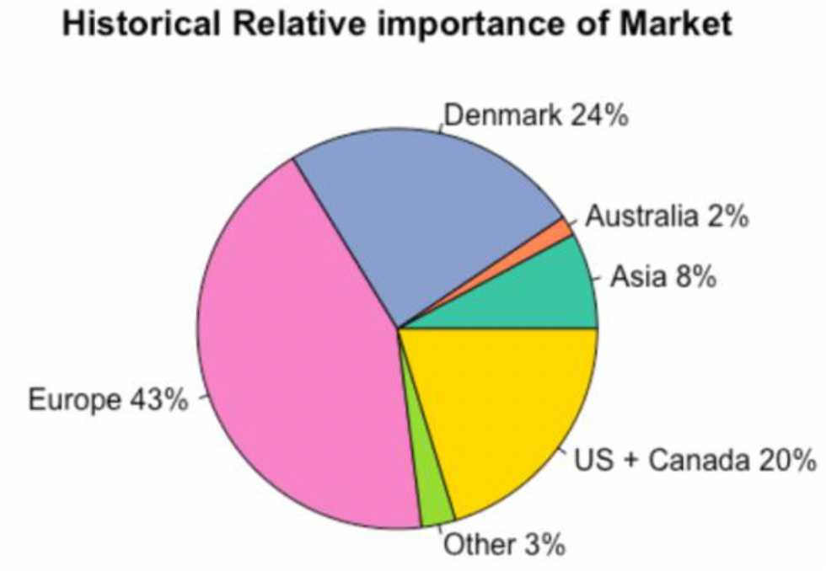
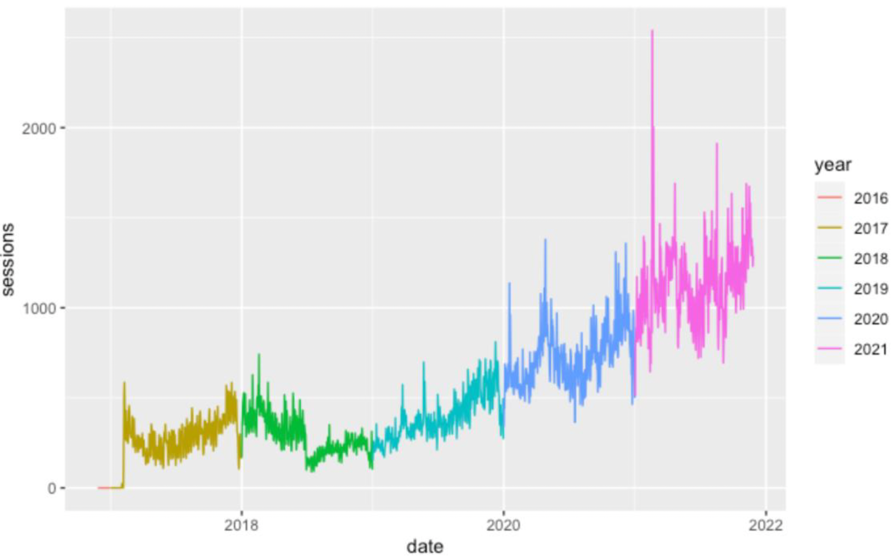
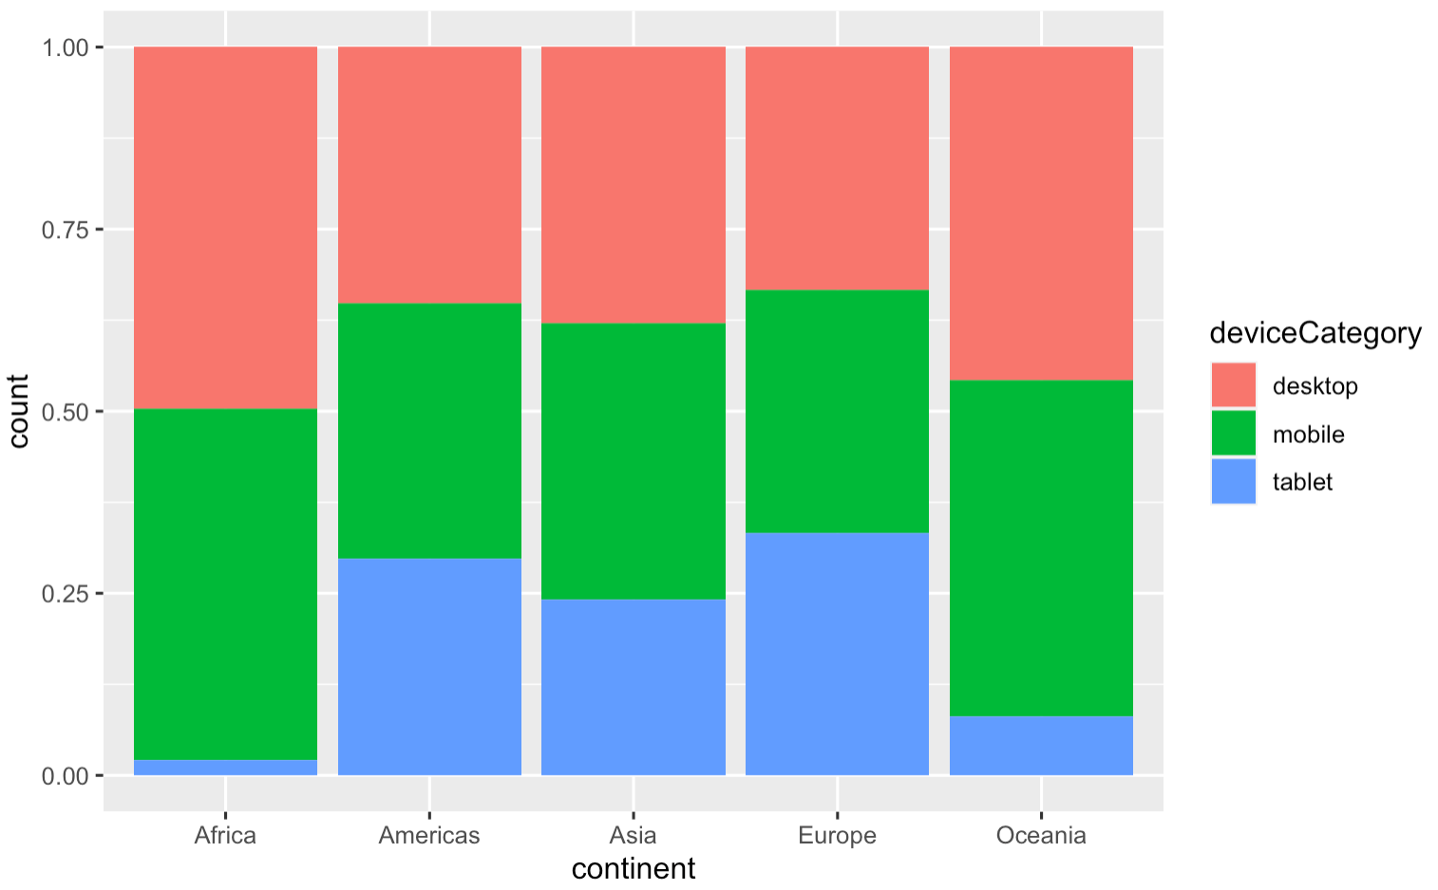
Continued growth in sessions throughout the years

Slide 5
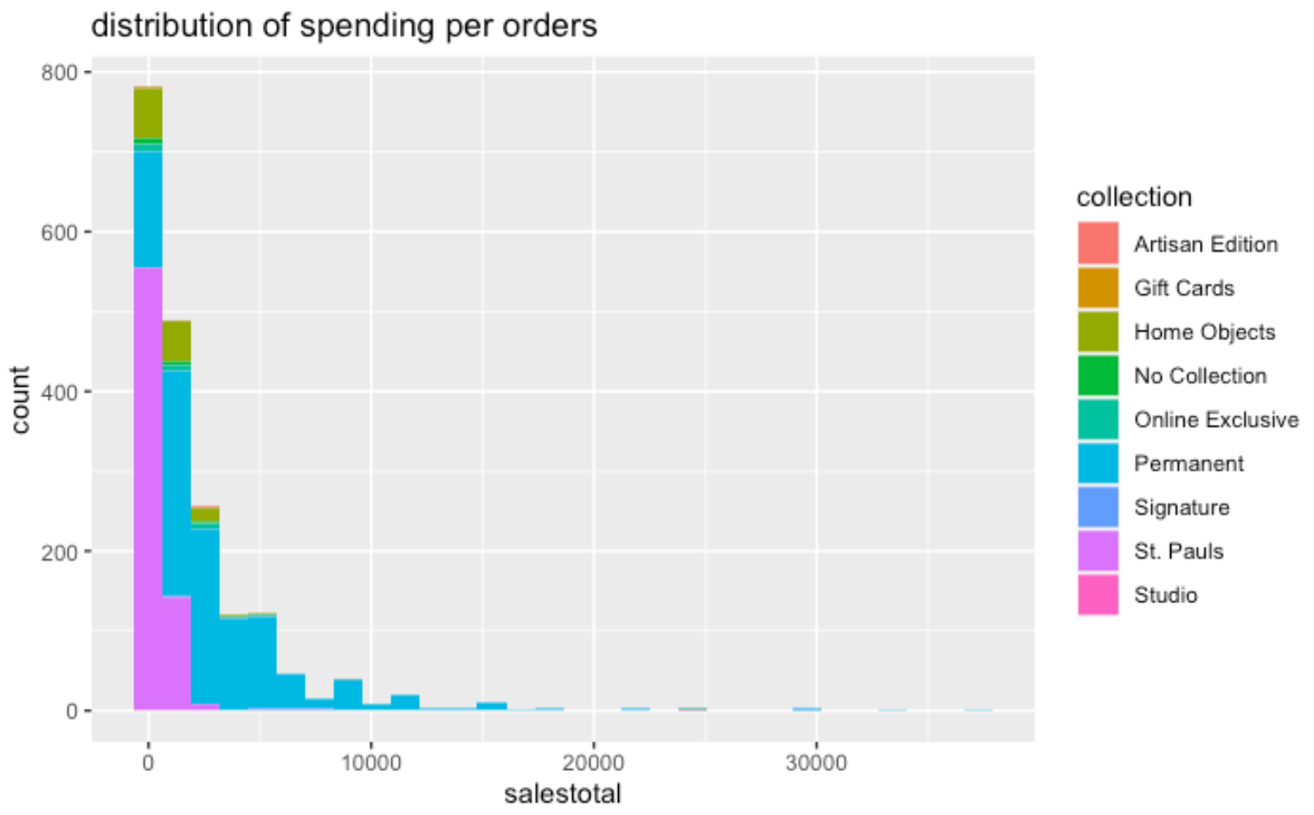
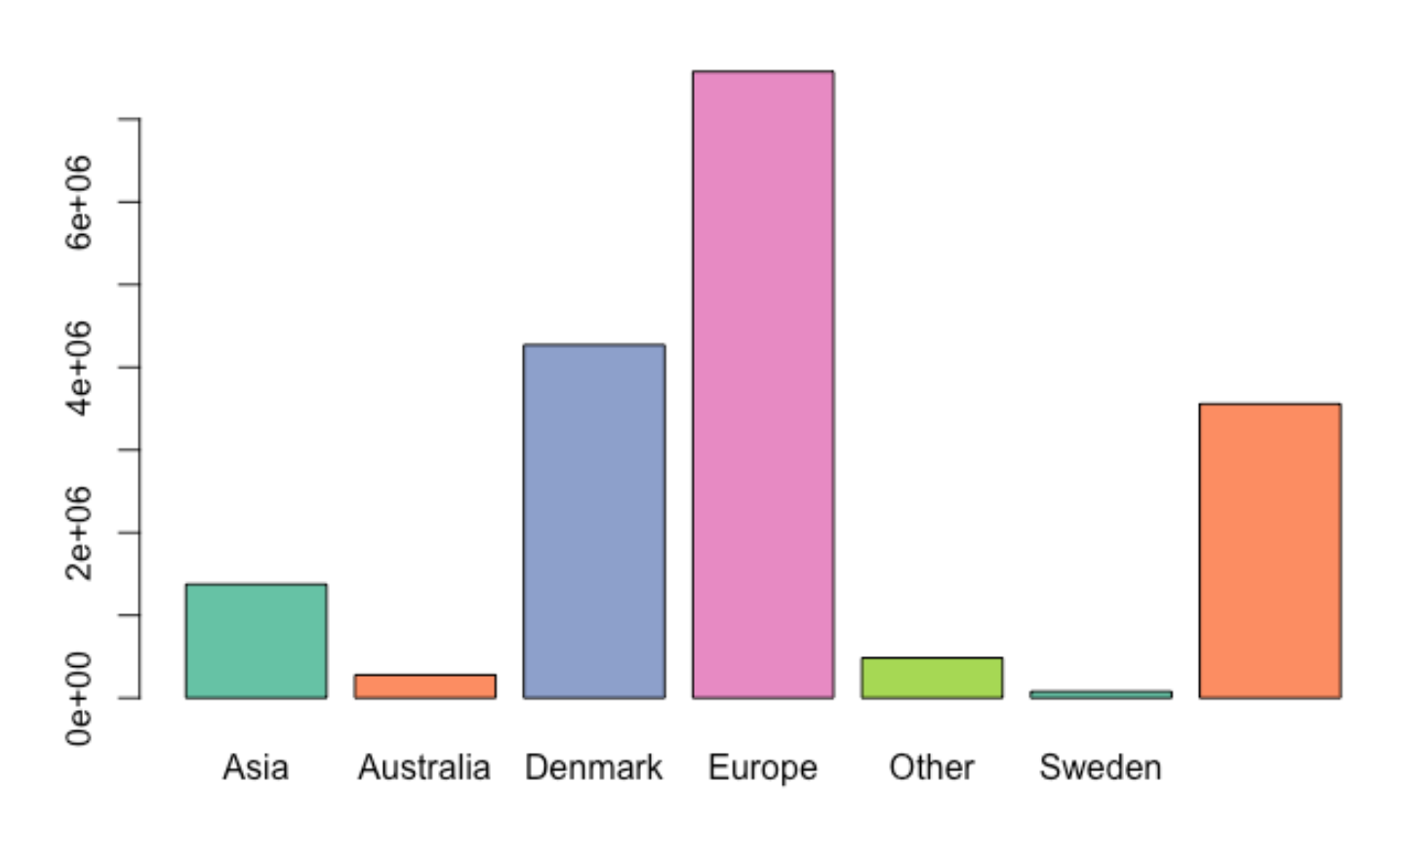

Slide 6
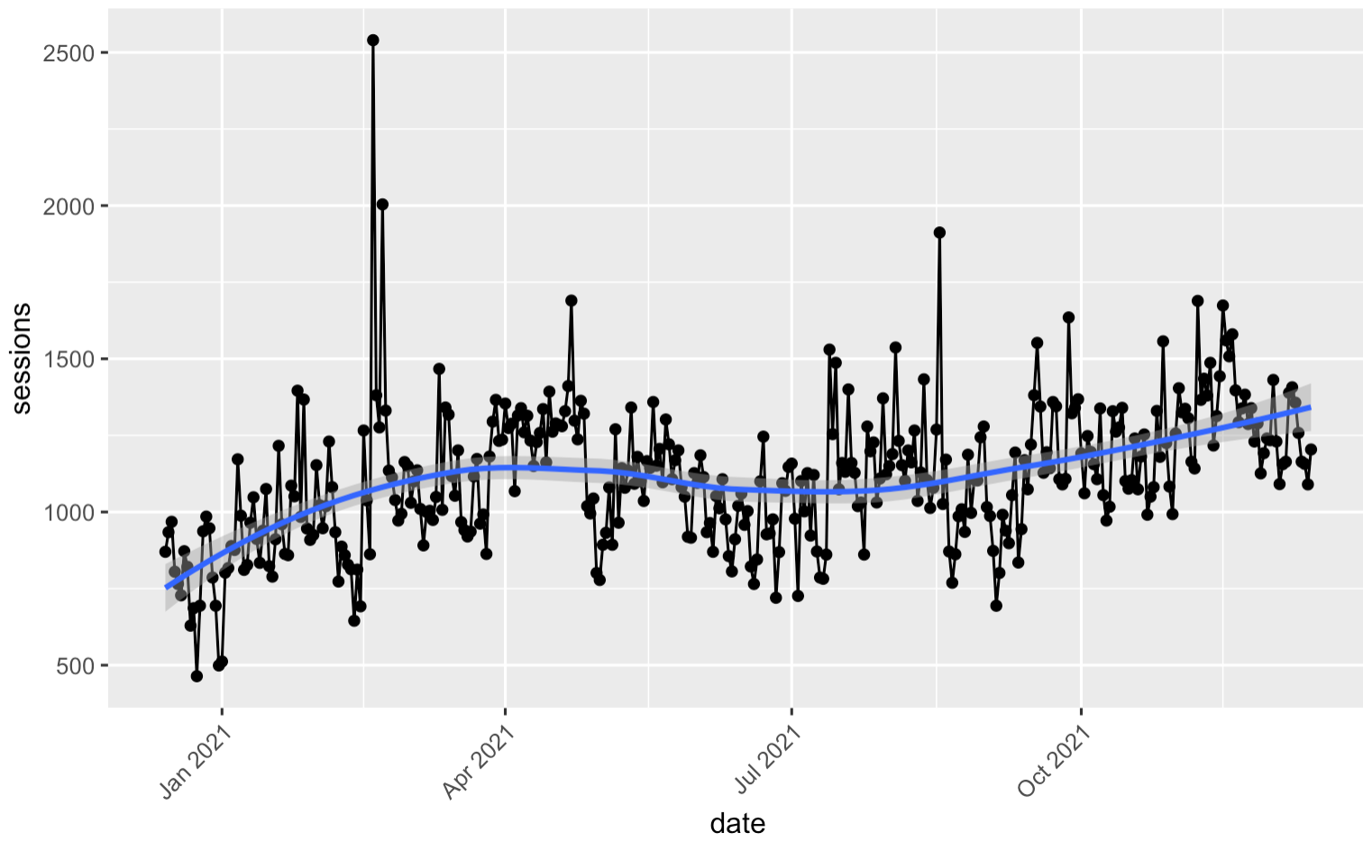
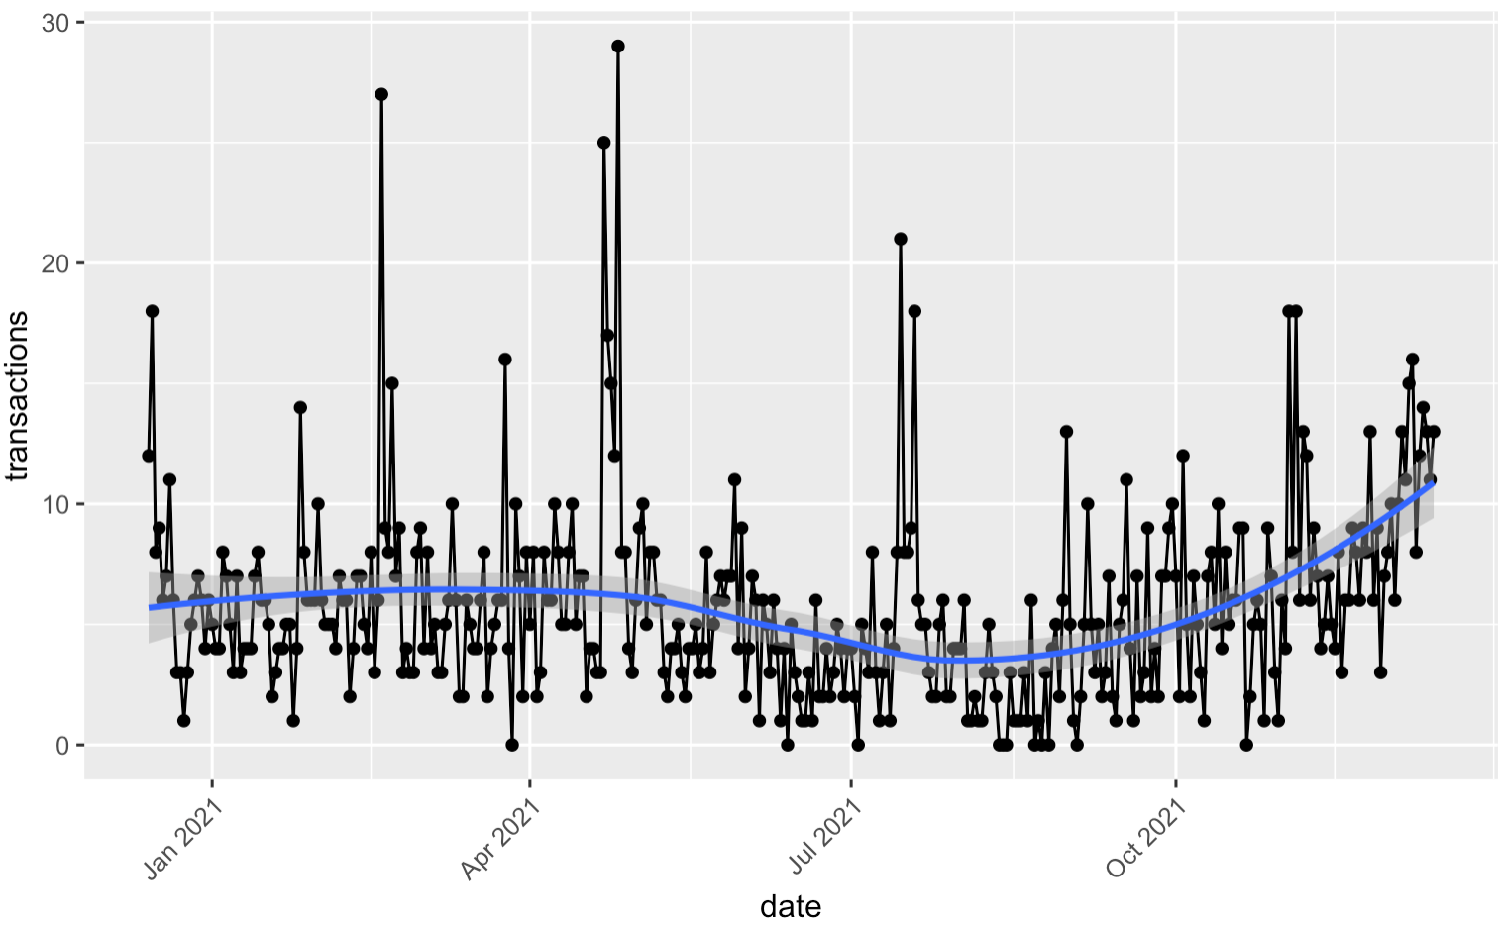
Sessions vs transactions during the last year

Slide 7
Part 1: Understanding the data
The ERP that contains sales data does not explain what is happening with the sessions that do not end up in a transactions.
Possible solution: combine internal data with Google analytics’.
Check the origin of sales vs the origin of sessions.
Do they match? Is there any pattern?
Notes:
Low quality of information leads to poor decisions.

Slide 8
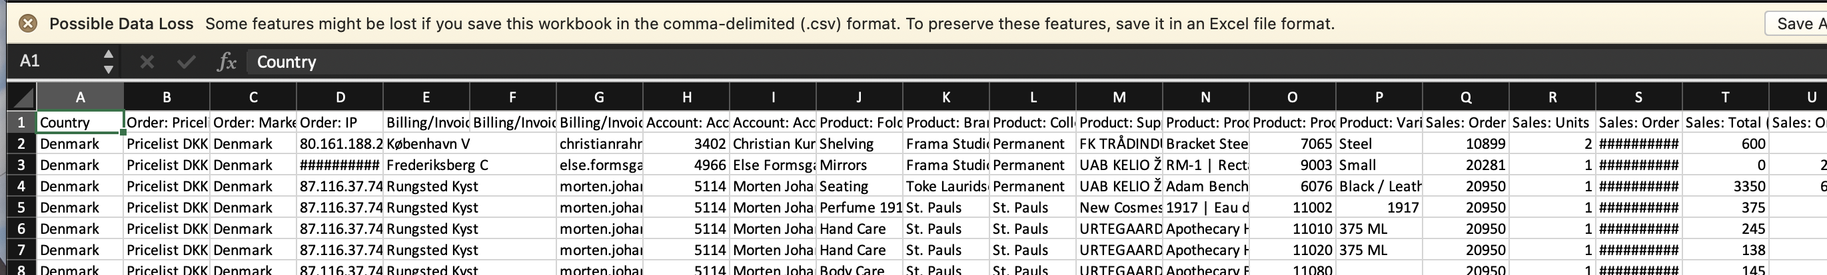
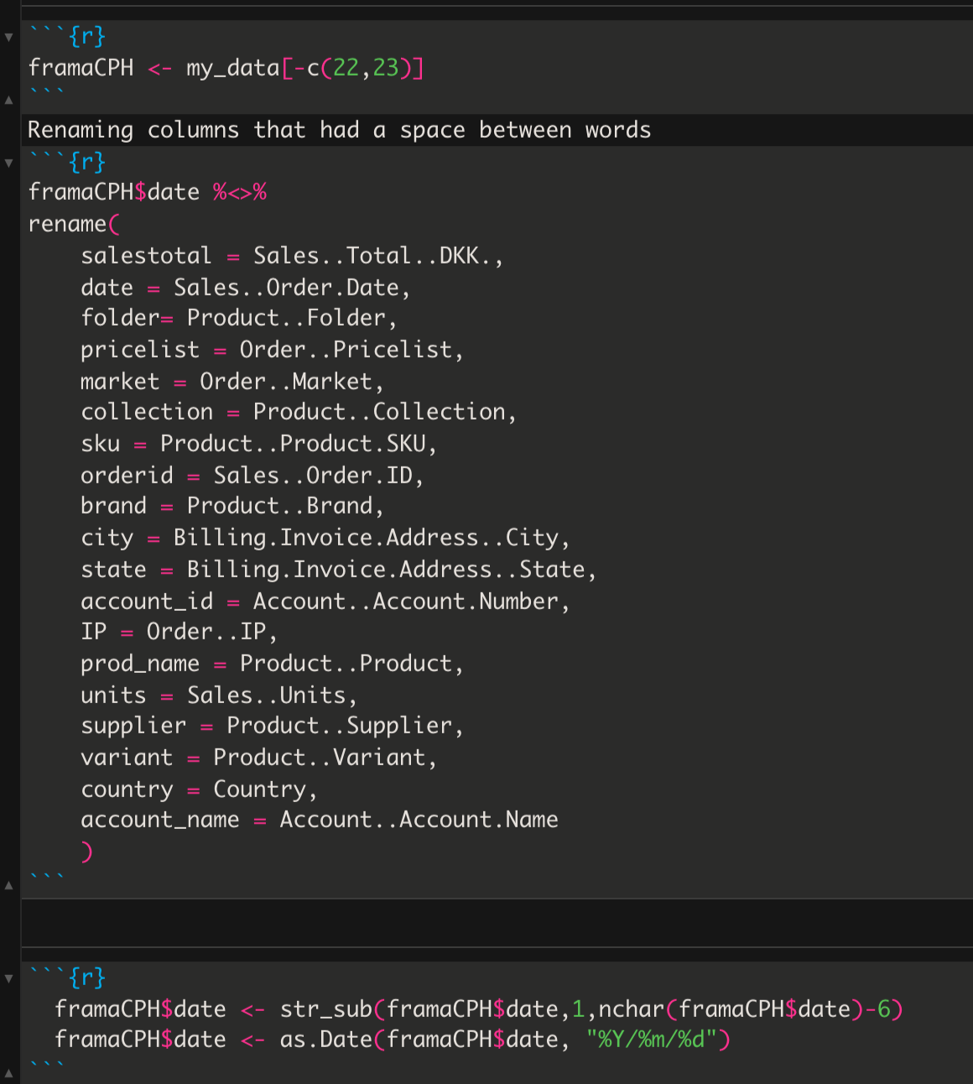
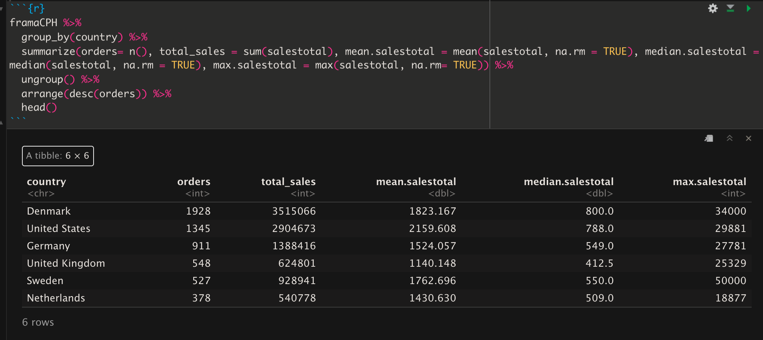
Local data

Slide 9
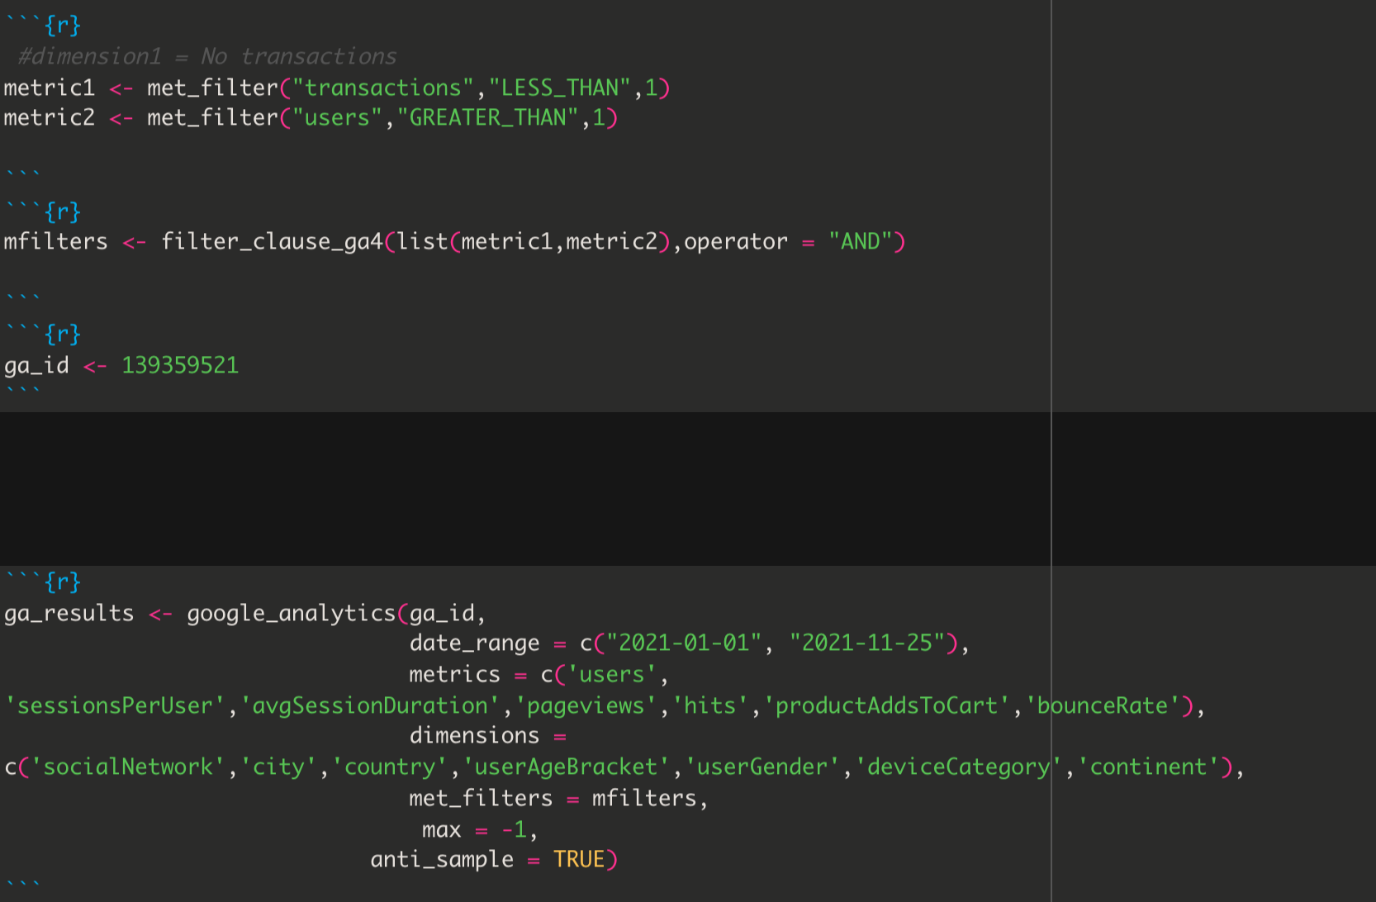
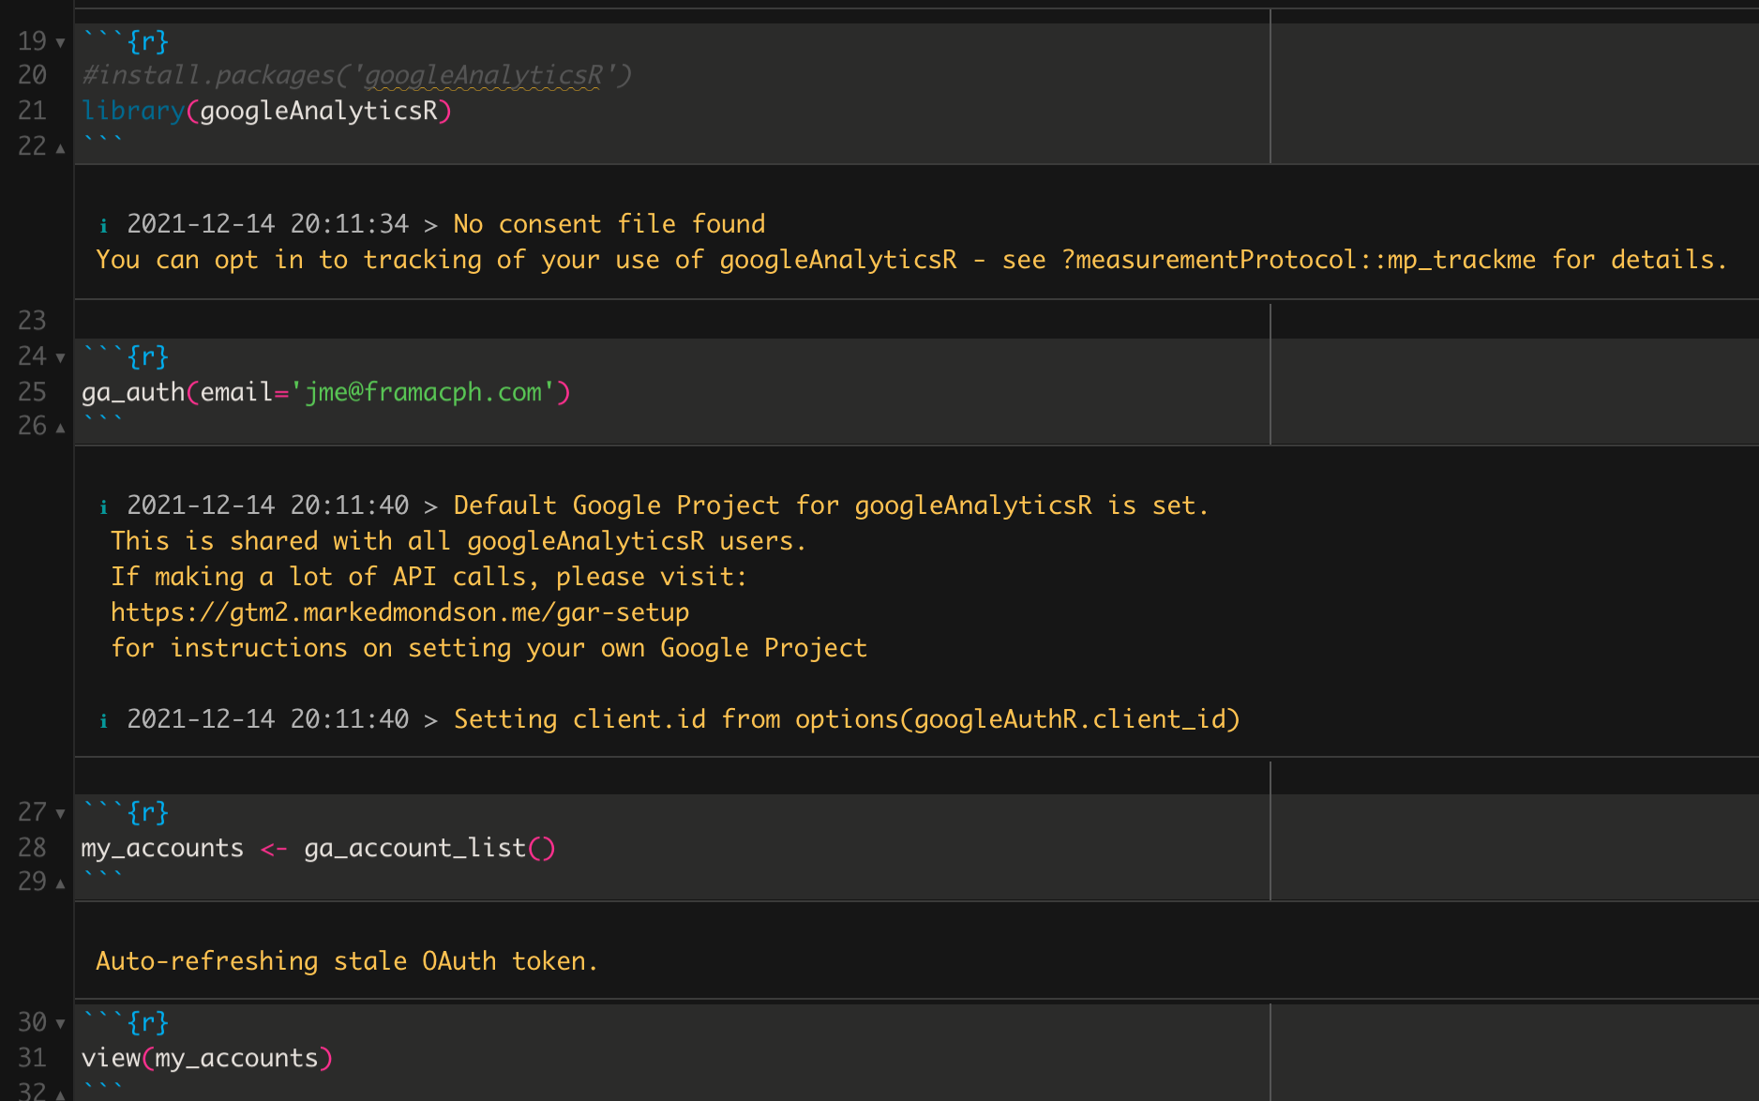
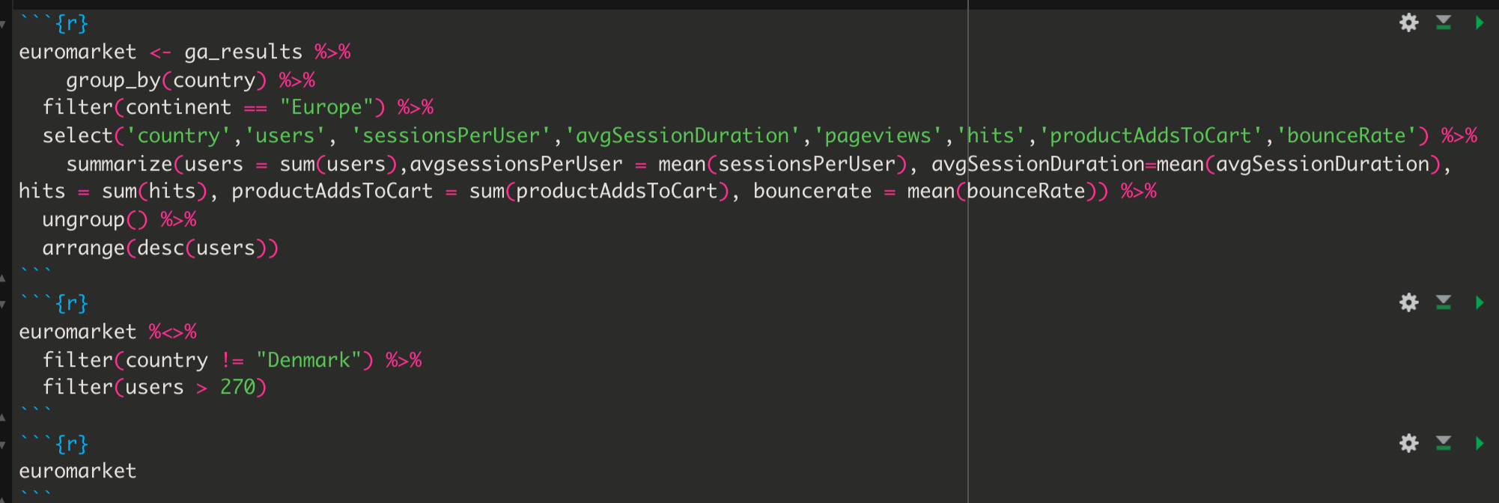
Google Analytics script

Slide 10
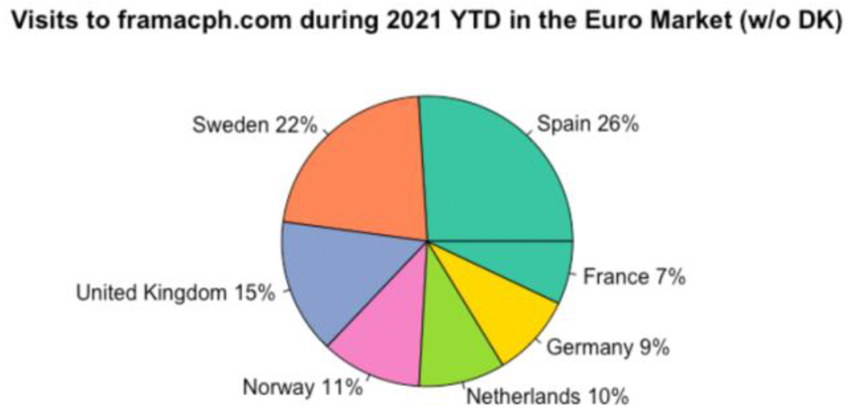
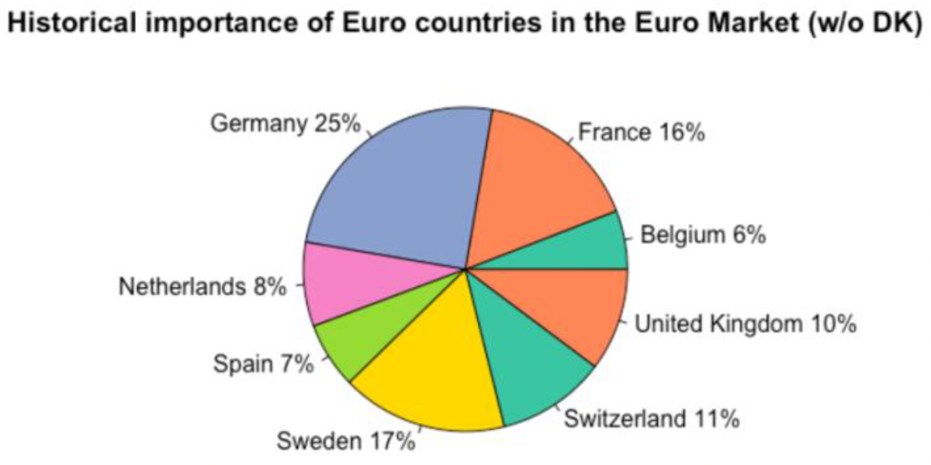
Part 1: The Spanish Case

Slide 11
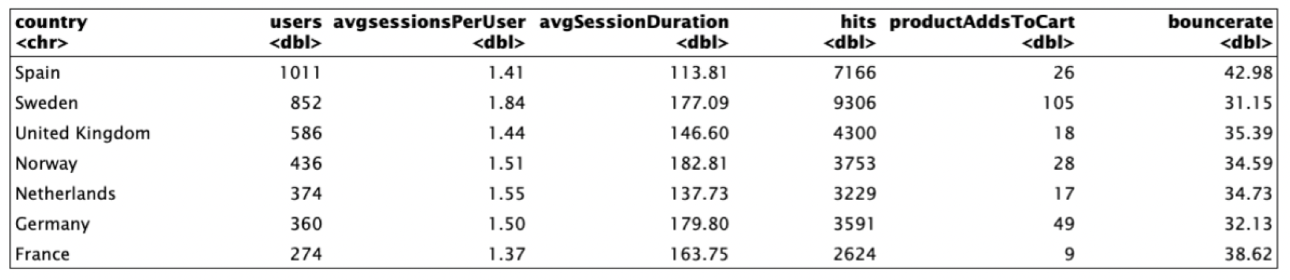
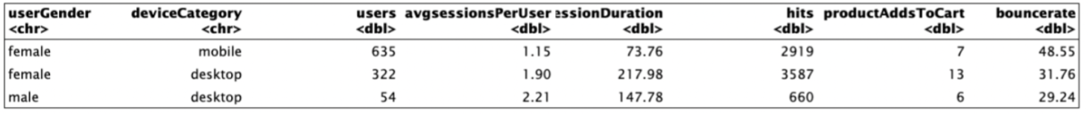
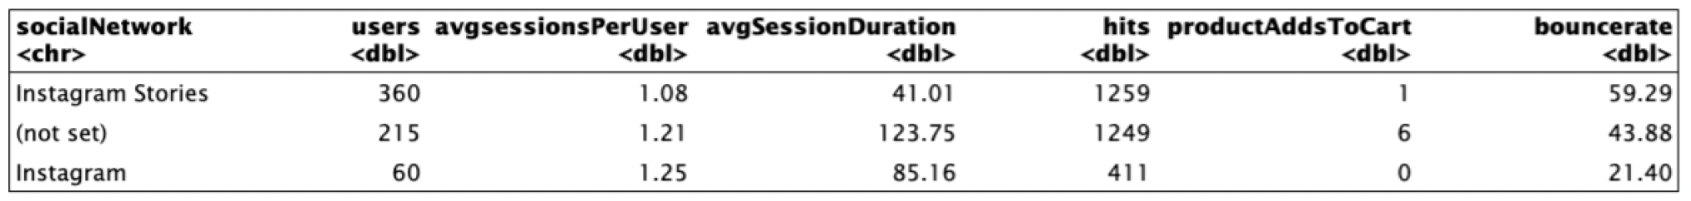
Why Spain?

Slide 12
Diagnostic
Spaniard women comprise more than 1/4 of the European visitors to Framacph.com, however they are on the sixth position in sales.
They mostly live in the two biggest cities of the country
>60% use their phone to enter the site, but the bounce rate is very high.
What is the problem? Prices, language?
Huge potential

Slide 13
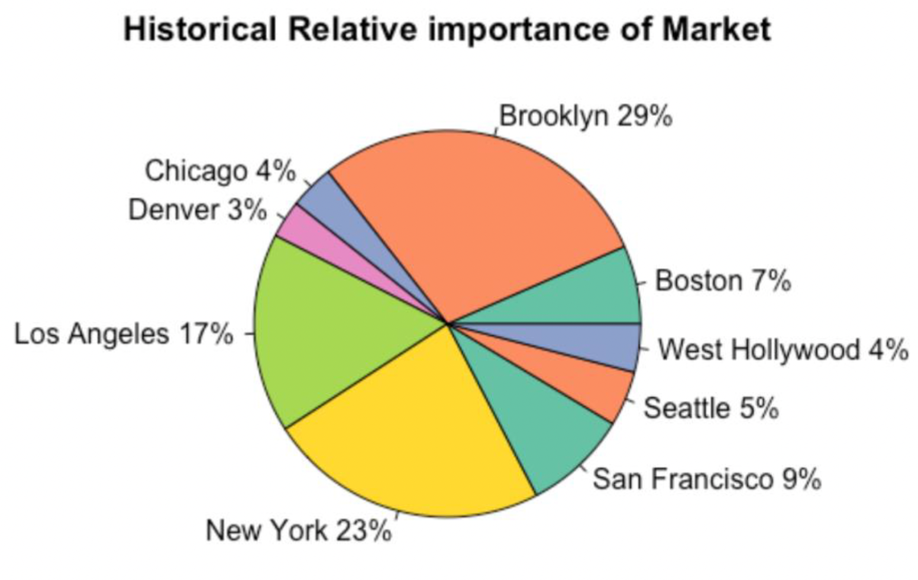
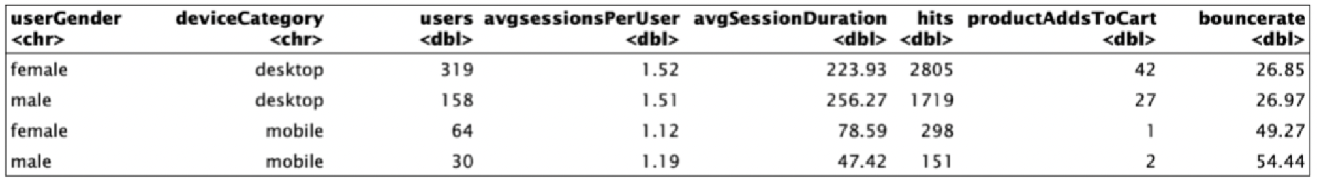
Part 1: The US Case
Good correlation between sessions and sales
60% of the audience is female vs 40% male
The age bracket analysis shows different results than Europe
Most importantly, very low percentage of mobile vs desktop users

Slide 14
2nd Part: NLP
What is the audience looking for on Frama’s website?
Objective: Use as a proxy of interest in the brand the name of the webpage that the users are visiting inside frama’s website.
This analysis will show they keywords that should be used when advertising in google or provide hints for advertising in stories in instagram.

Slide 15
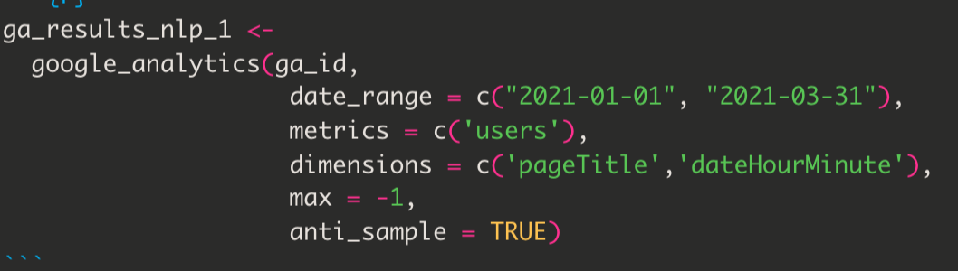
NLP Workflow
Get the Page Title and date and time of the session and how many users were visiting the site from Google Analytics server in 4 chunks. I Had to append it because it was very big.
Tokenize the title of the pages, count the words and tidy up the results.
The final results shows the words and bigrams that attract the most to the customers visiting Frama’s website.

Slide 16
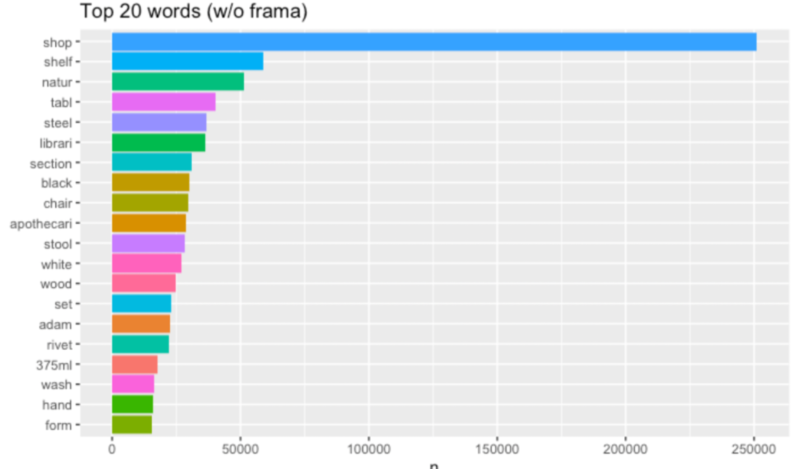
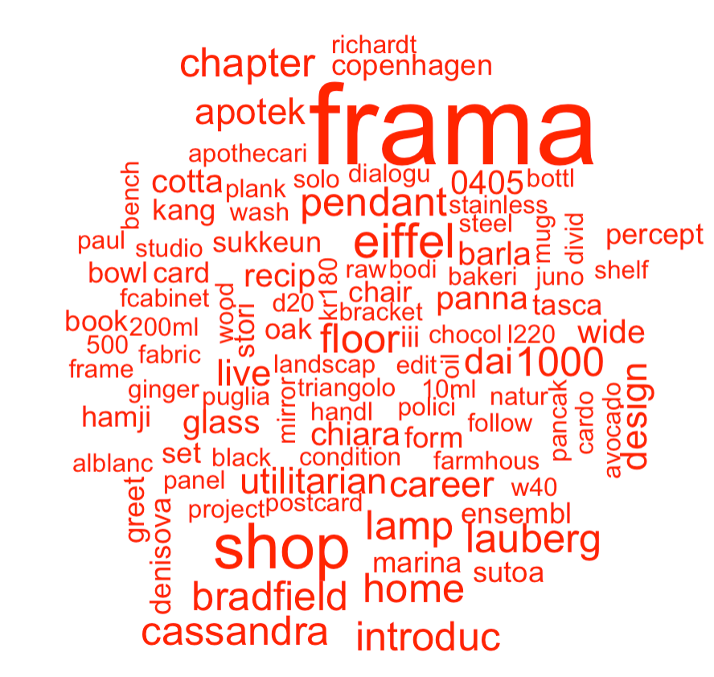
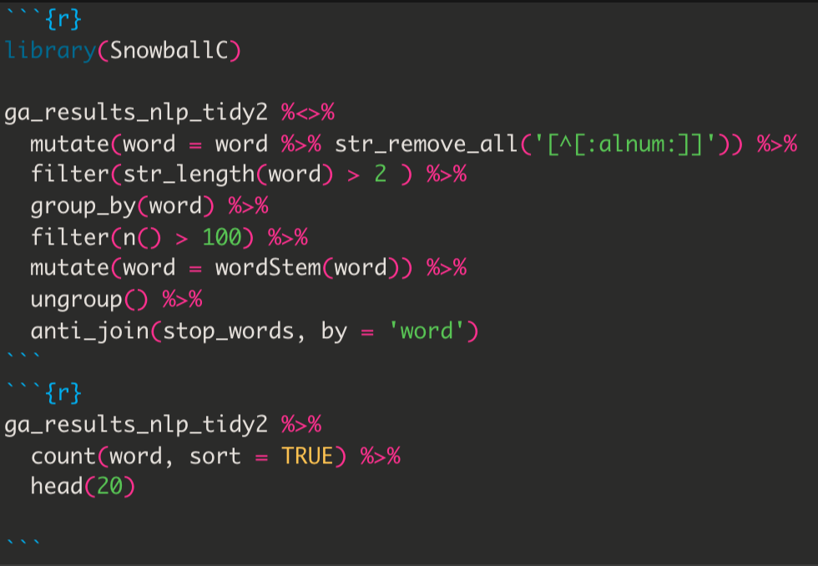
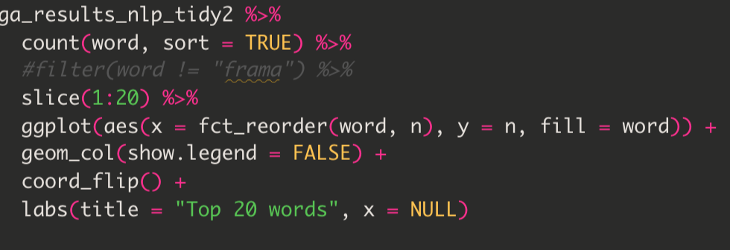
Results

Slide 17
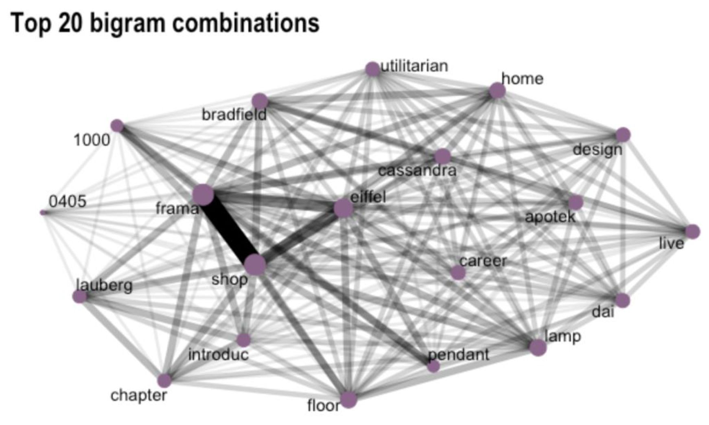

Slide 18
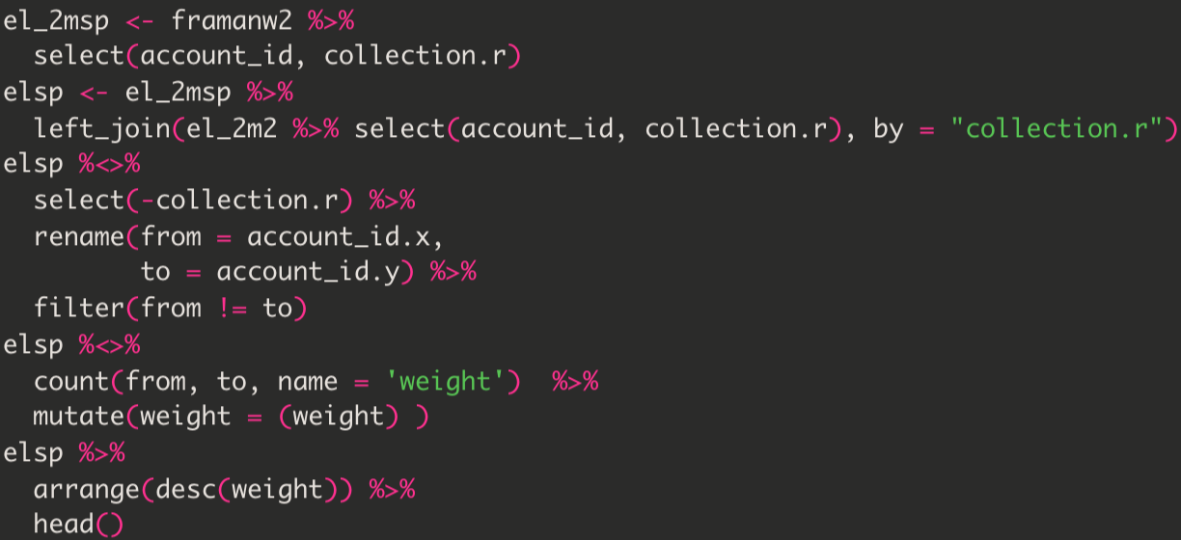
Part 3: Network Analysis
Created a 2 mode network: Customers and collections.
Every product bought by a customer is part of a collection, I used this variable as an affiliation
Then join customers by affiliation to the same collections. The resulting weight is the number or collections they share, hence the more similar they are.
Notes:
There were much less categories so the results were going to be more clear.
Converted categorical variables into numericals, so I could do the join. I tried with 3 of them and chose collections.

Slide 19
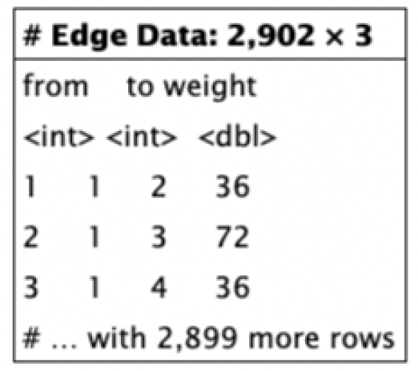
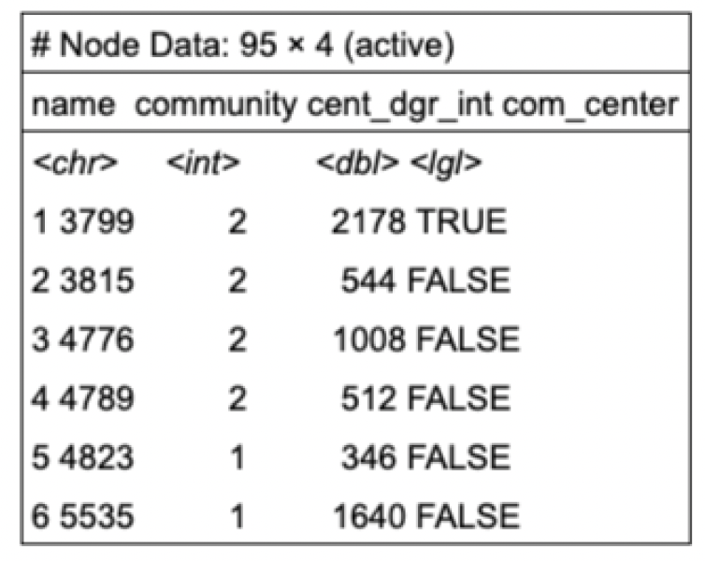
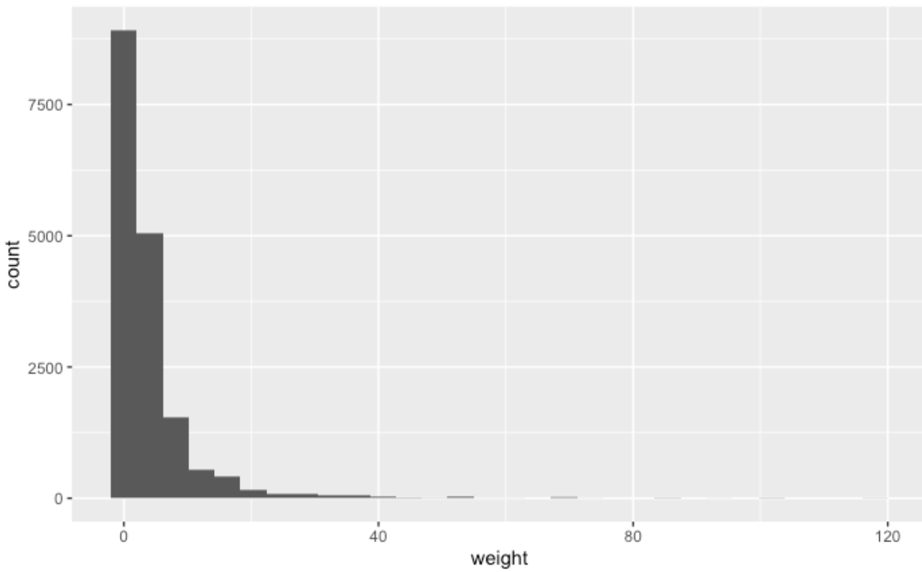
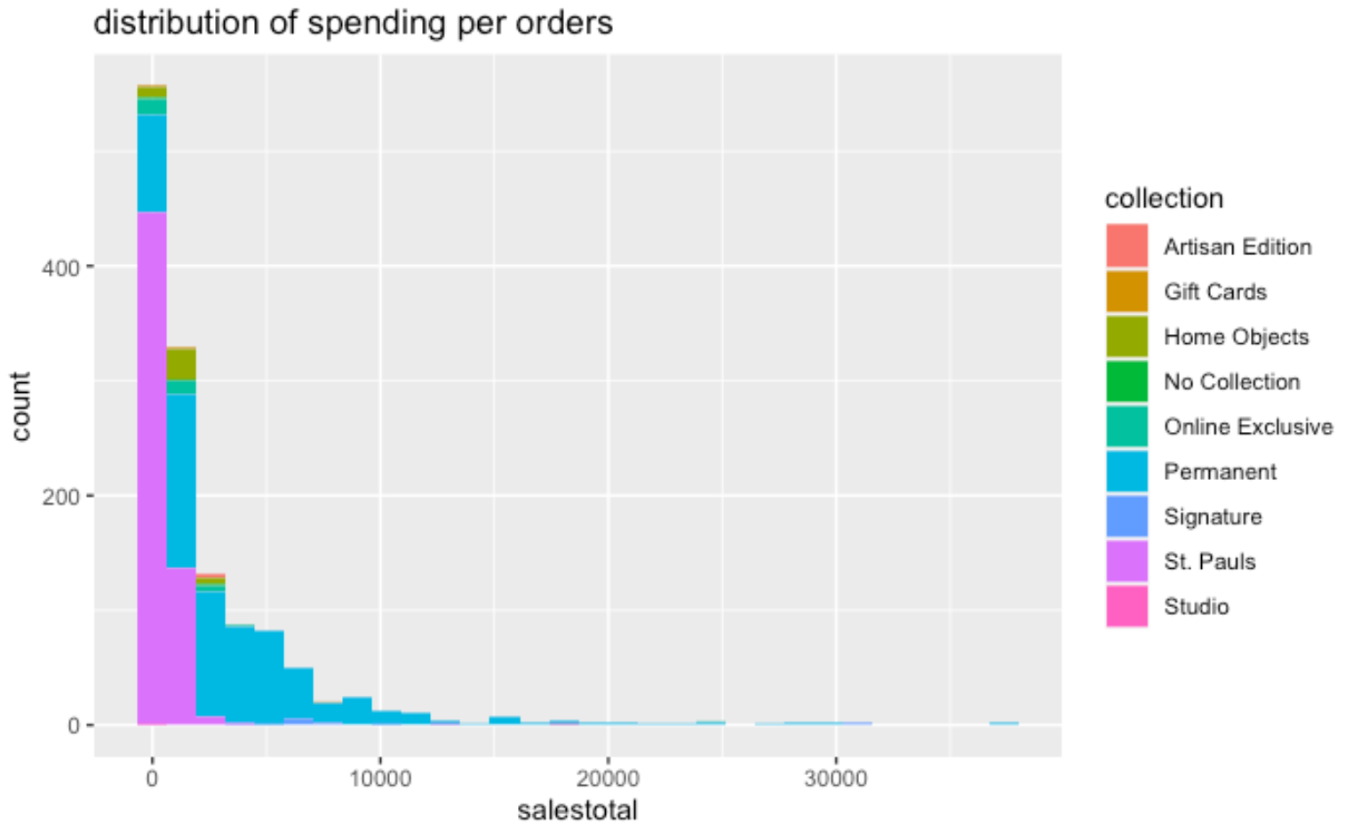
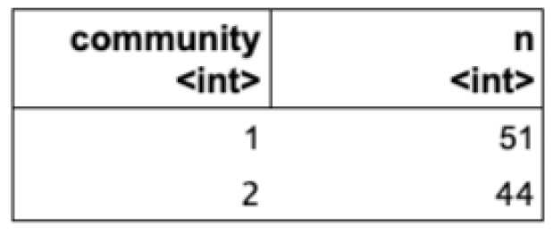
Network Analysis: The US Case
Filtered weight lower to 4 and higher than 20
Only analised the top 50% customers with higher weight

Slide 20
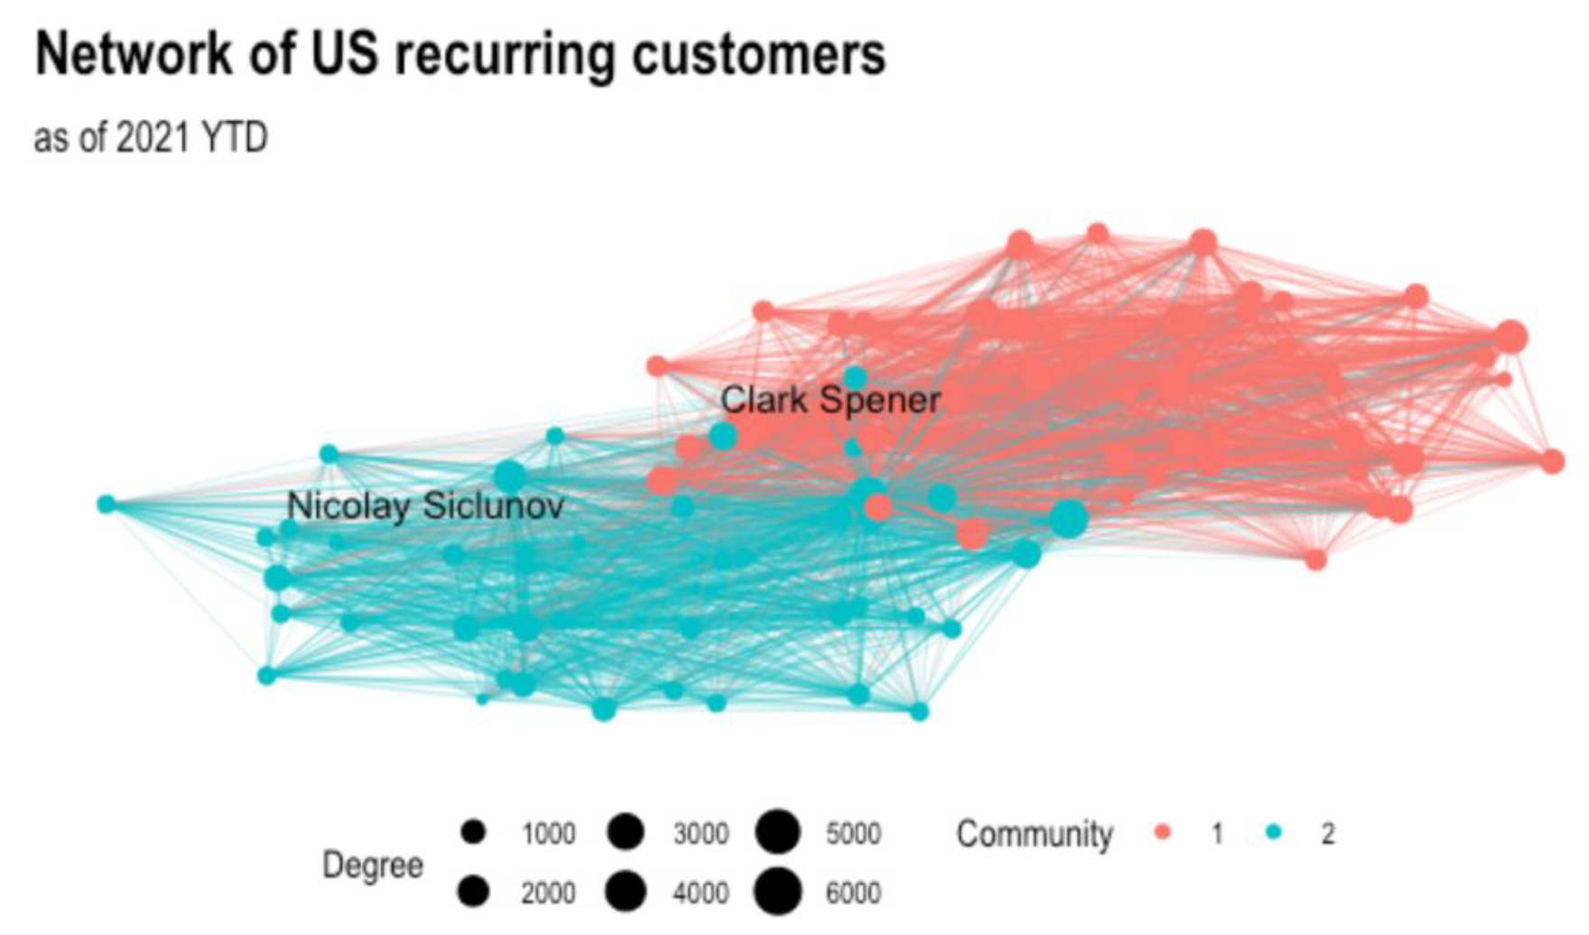
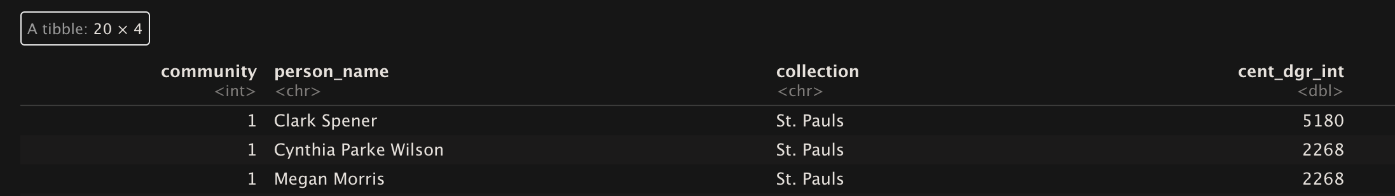
The results are very interesting
Community 1 was St Pauls (Apothecary)
Community 2 was composed by collections related to furniture!

Slide 21
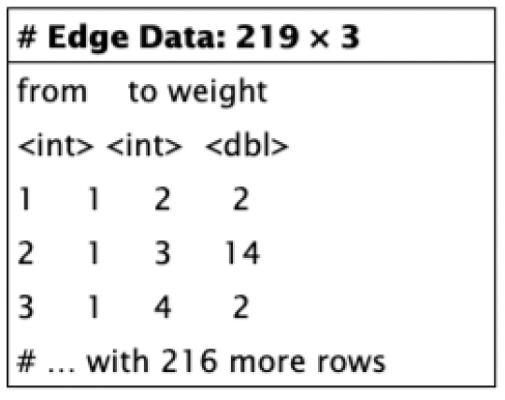
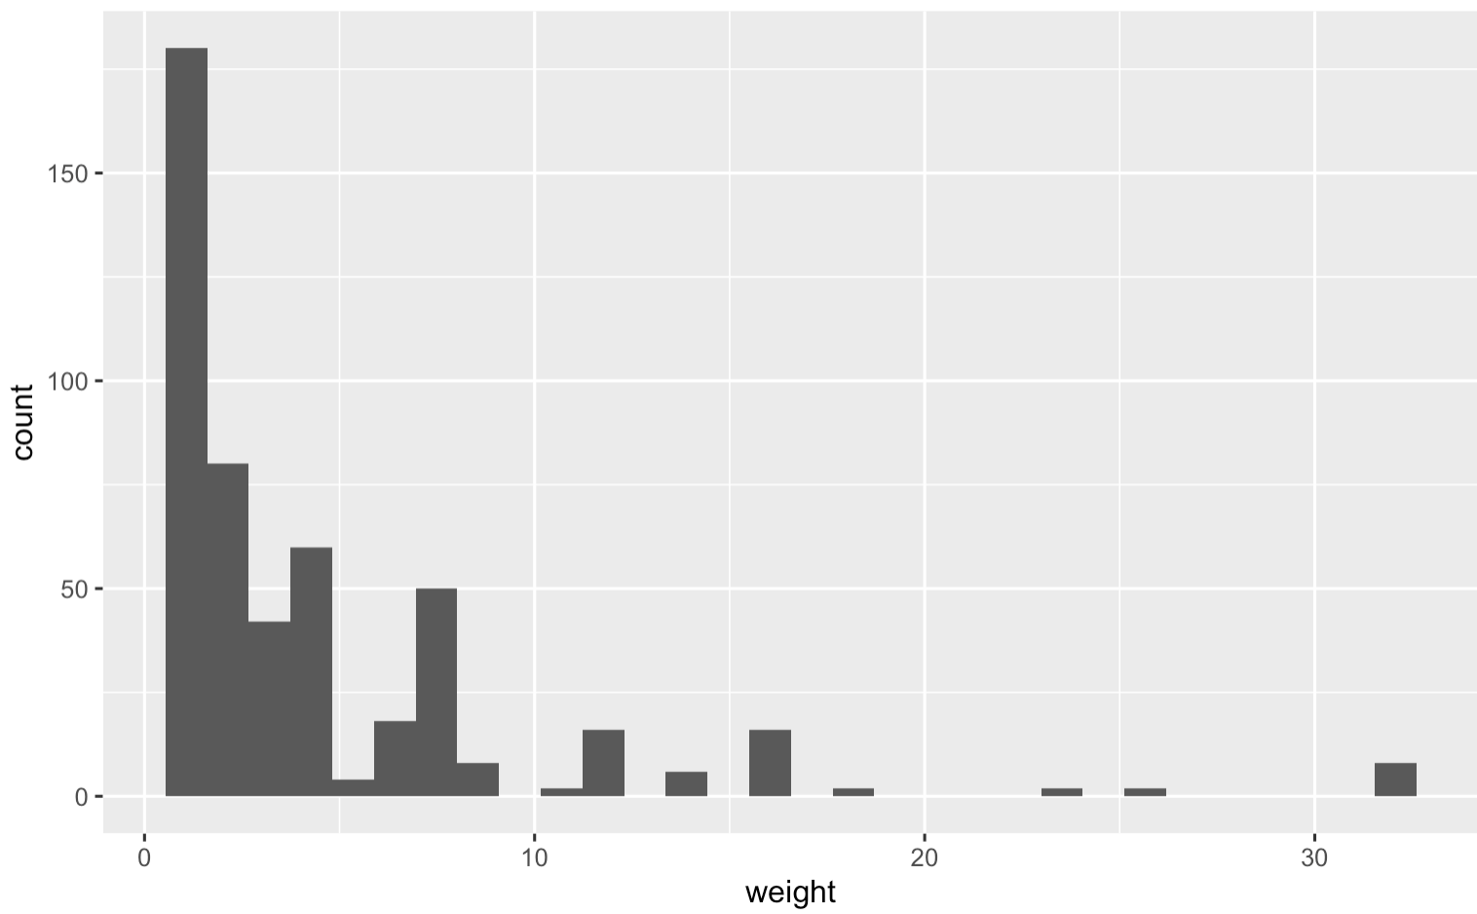
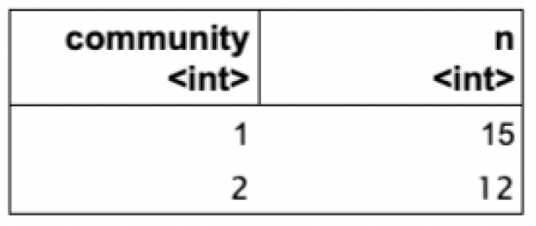
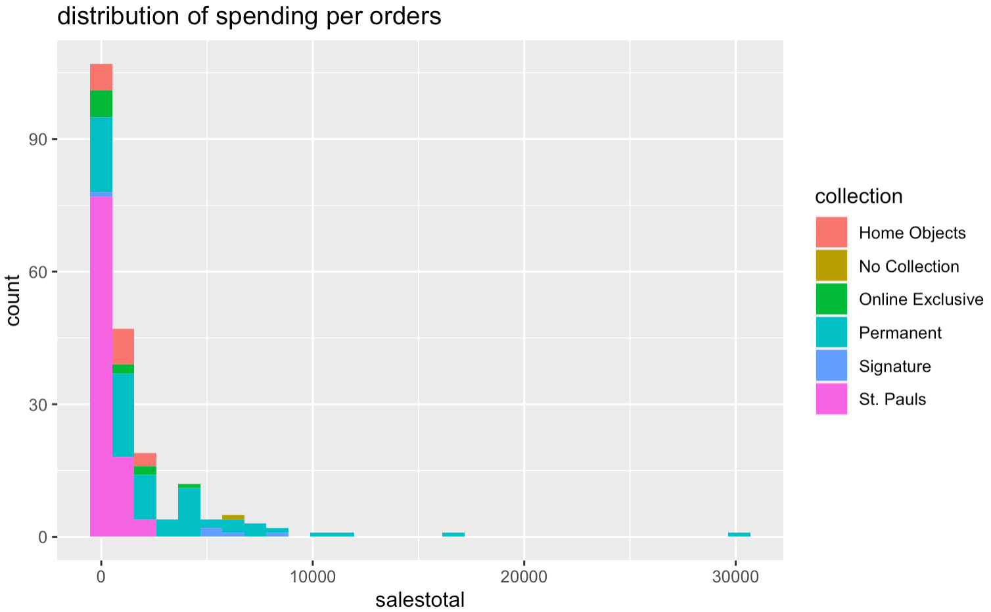
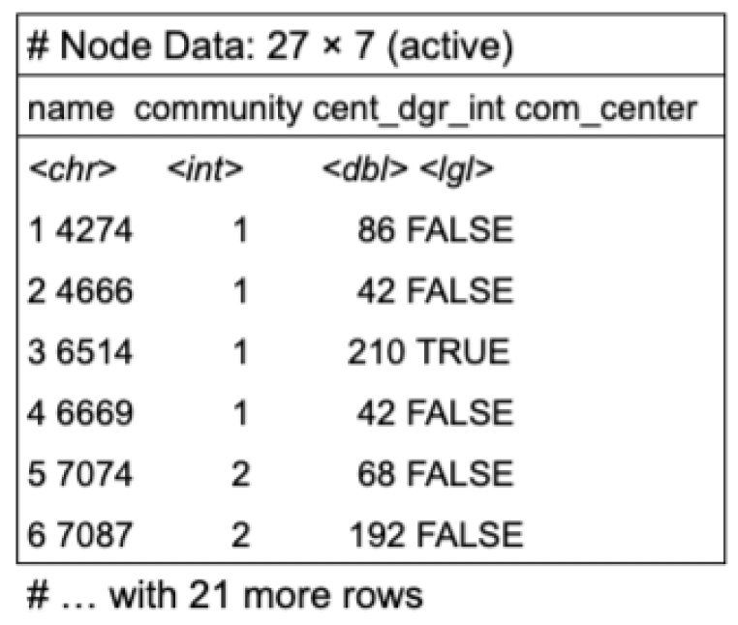
Network Analysis: The Spanish Case
Filtered out weight lower to 2
Analised the top 90% customers with higher weight

Slide 22
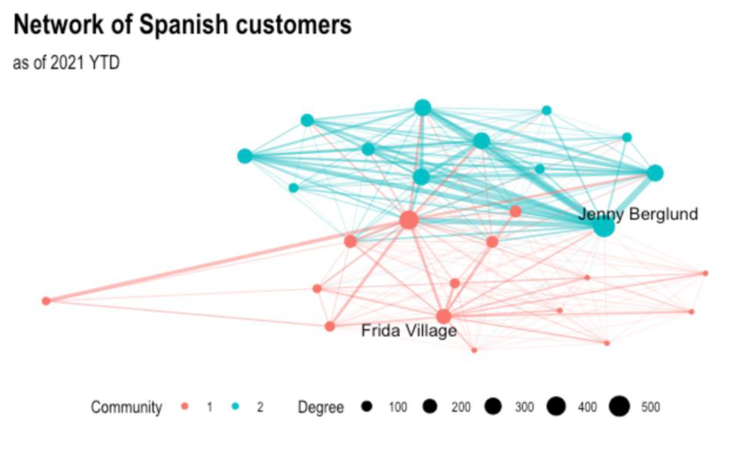
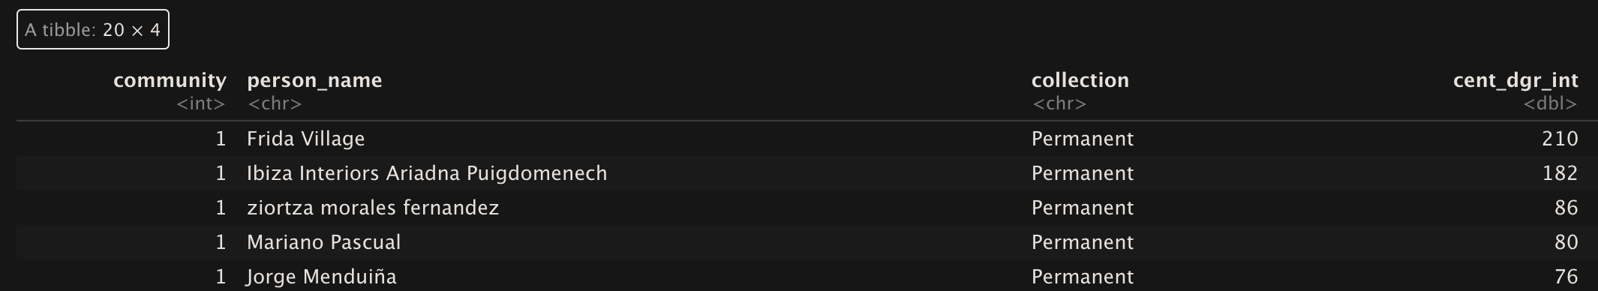
The results are very similar to the US
Community 1 was furniture and smaller collections
Community 2 was Apothecary!

Slide 23
Interpretation of the results
Big spread between Sales and interest in the brand.
Relevant results in the NLP section. Potentially could be used for keywords in future advertisements.
Somehow insightful results in the network analysis section. Two main communities in each of the analysed groups show that reflect the most sold products by the company.

Slide 24
Conclusions of the study
While somehow basic, the analysis proved to show relevant aspects about the business: 2 diff. segments, two diff. strategies.
The teams of the company will use this data to leverage their strategies. It would be interesting doing the same analysis for brands and family of products to create more focused segmentation.
Notes:
The results were contrasted to current reports and there were several coincidences and many discoveries were found, in much less time, manual work and without almost any context knowledge.

Slide 25
Limitations
While useful some analysts had their reserves about the numbers.
They argued that there is a very poor integration between the site and google analytics, hence numbers could be a bit skewed.
The company is implementing a new website soon and this analysis will be done again with more reliable data.
Impossibility of importing the script and its results :(

Slide 26
Thanks

Slide 27
Notes
Structured (20%), less storage, easy to manage, easier to analyze with PL. Expressed in tabular format: excel, qualitative & quanti. Relational data bases, SQL
vs unstructure data (80%) image, audio, tweets, text data... Big part in the preprocessing of it is bringing it to a structured format.
Array, several matrices. Data frame is a table, not necessarily a matrix. A matrix is a mathematical object with several dimensions (r&c) that can’t have mixed type of data. Lists are overarching containers, they can contain different data objects (vectors, arrays, matrixes, data frames, etc).
Tidy data: each variable has it own column, each obs has its own row, each value has its own cell. It is consistent, easier to use the same workflows
Tibble: strings are not intrepreted as factors. Rownames are dropped, more convenient way of viewing the data.
Piping: we don’t need to call the object multiple times, each line represents the order of the argmuments of the function. Carry on a chain of operations. Much better than nested functions.

Slide 28
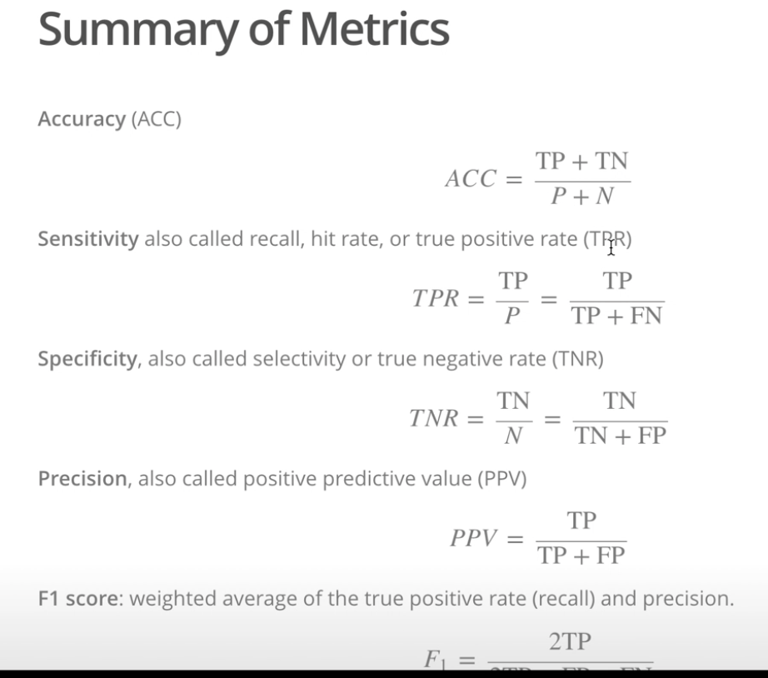
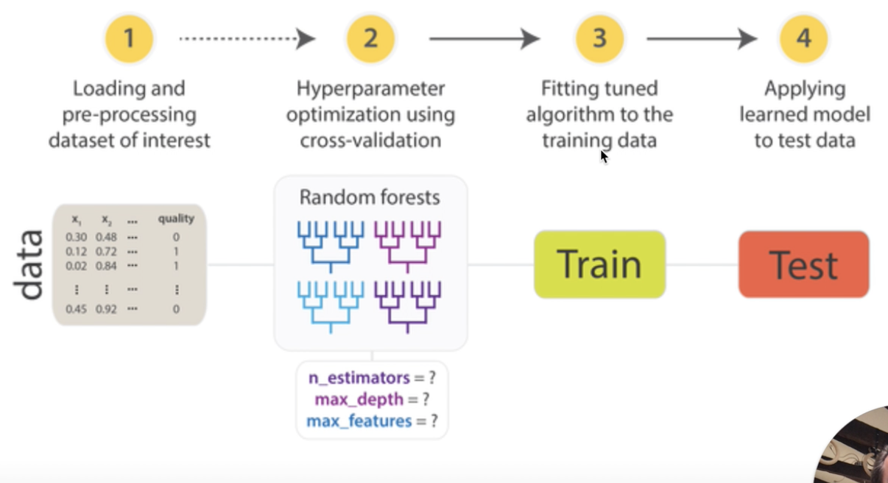
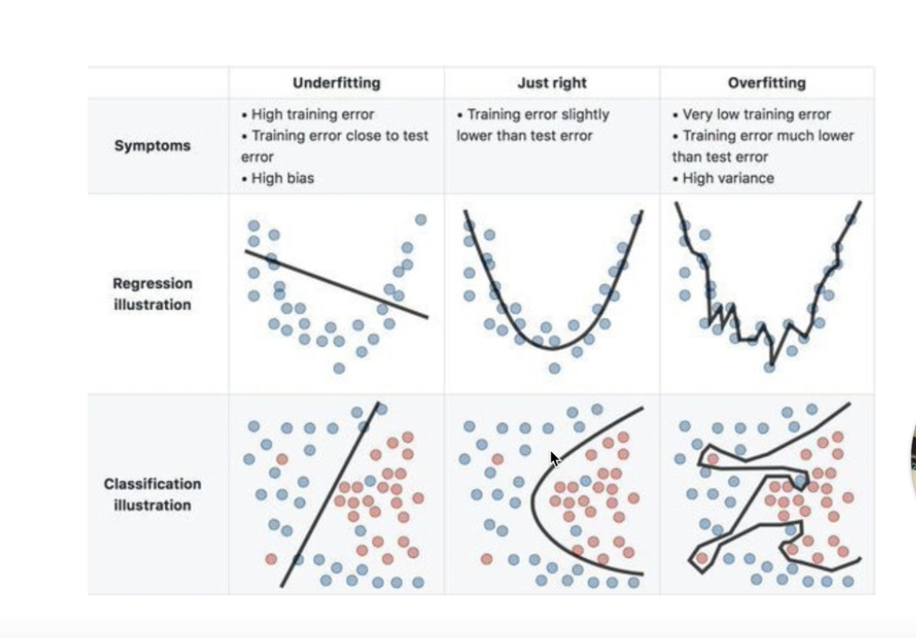
Notes2
Machine learning, using algorithms, parse data and learn something from it, without reliying in rule based programing.
Look at the students that were dropping out before and tell me which have tendency to drop out now.
Supervised: regression problem. Unsupervised:classification problem: identify general patterns in the data. Dimensionality reduction: if many of the variables are correlated, then we can compress them (PCA).
Clustering: the objects in the same group are more similar to each other than those in other groups. K means, we start with a centroid point and which one are tehe closest. Hierarchichal, each point is its own clusters and then the algorithm joins all the very close clusters.
Not interested in the real world but in predict what are the things more likely to happen. Neither interested in the causes of the phenomenons.
OLS, minimize the sum of the squares errors between predictors and the observed outcome. Rsquared tells how good is the model, the assesing predictive power of the model.
Confusion Matrix or classification table: True Negatives and Positiives vs False Negatives and possitives
Evaluate the models in data that has not been fitted on. Is very important to pick the right model, with the right complexity and to avoid overfitting.. It will result in reducing these type of errors: Bias Error, oversimplification (linear example). Variance error, over specification (over fitting).

Slide 29
Notes 3
Crossvalidation: split the dataset in a training and a test sample. Fit your model on one dataset, evaluate its predictive power in the other. N-fold cross validation is where this process is repeated several times during the hyperparameter tunning, (2nd stage).
Decision tree: splitting in categories and the problem is to restrict the depth of the tree. They tend to over-fit. Random forest introduces randomness via bootstrapping, boosting and ensemble technics.

Slide 30
Network Analysis (Need to explain the code!)
Created a relational database to create the edges.
The direction of the edge does not matter. Undirected network. Is the matrix is symmetric . Reciprocity, assortativity or Matthew effect are not relevant. Small world would have been interesting, because they are closer to other communities, they can explain their behaviour.
The nodes tell us information about the elements and the edges about the connections between the elements
Nodes are the customers, edges are the relations between them (sharing the same taste by buying the same collections = similarity)

Slide 31
Centrality
Degree: to how many nodes is a node connected. Only looks at the first degree of separation
Eigenvector: it matters to which nodes are you very well connected. Weights a node’s degree centrality by the centrality of the nodes adjacent to it. A higher eigenvector node is connected to very well connected nodes.
Betweenness centrality: the shortest way of communicating from one node to many others. If you remove this node, then the network will be disconnected.
Clustering (community detection): form groups which have a maximum within connectivity and a minimum between connectivity.
Louvain Algorithm: hierarchichal clustering, try to merge communities in order to maximize the modularity function.
Density, how connected ar the nodes between themselves. Transistivity: how much the network tend to be locally clustered.

Slide 32
Community detection: neighboorhood could have been used to go deeper in the clusters

Slide 33
Notes 5
Tidyverse ecosystem, based on the principles of SQL.
Data is stored into objects. C: concentrate.
If we combine 3 diff vectors we get a string of the less restrictive type.
When indexing, R will start with 1 instead of zero
If, then, else. Loop is a continued if. Helpful to iterate. While repeats, until the condition is not fulfilled anymore.

Slide 34
Notes 6: NLP
Text (sentiment, predict class, topics, similarities (semantic or literal)) at such vs elements of text (entities, language use, n-grams, relations).
Bag of words, just the very important words without declinations: We need tabular data and features so the computer can understand it.
TF-IDF: term frequency –Inverse document frequency. The importance of the word among the whole document. Term specificity

Slide 35
String manipulation
With the bag of words we can do all sort of string manipulations.
We work with token lists, text segments: words, sentences...
Tidy: every word has one row.
Unnest token; output is the word, input is the the text and token is word, since we want to have only words.
We need to remove stopwords, words that lack sense without context. We do it by doing an antijoin: exclude obs that appear in both databases. Minute 37 for more info

